Slide 1
Hand in hand we can achieve great things!
PCC Plenary meeting Rome
Dave Lovell OBE, EuroGeographics Executive Director
21 November 2014

Slide 2
EuroGeographics Membership
61 members
46 European countries
2
2
Full membership
Out of scope
2
2
2
2
2
2
2
2
2
Rue du Nord 76
Noordstraat 76
1000 Brussels
Belgium
3
2
2
Malta
www.eurogeographics.org
Notes:
HQ in Brussels – close to administrative and legislative bodies of the EU, Continuing Membership growth, Clear recognition of members roles
MB of 9, including President IvB, 5 responsible for Cadastre.

Slide 3

EuroGeographics – Activities
  Pan-European
  Products
  Representation & Strategic Communications
EuroGlobalMap (Open Data)
EuroBoundaryMap
EuroRegionalMap
EuroDEM
Political ownership of geo-information +
European Location Strategy
  Interoperability
  Projects
  Knowledge Exchange
  Networks
Business Interoperability,
Cadastre and Land Registry,
Emergency Mapping,
INSPIRE,
Policy,
Positioning
State Boundaries of Europe
Quality.
The European Location Framework + EuroGeoNames +
Notes:
The Association has four inter-connected activities: Representing our Member’s Interests, helping Members to exchange Knowledge and experiences, using interoperability Projects to develop the framework for the European Spatial Data Infrastructure and providing authoritative pan-European geo-information products aggregated and harmonised from European UN Member States NMCAs.

Slide 4
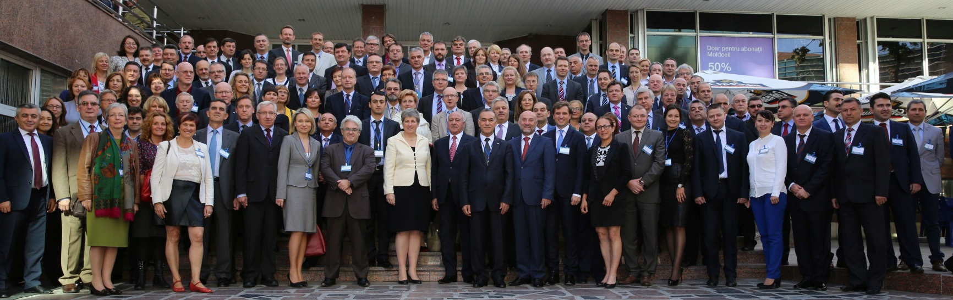
EuroGeographics General Assembly 2014
150 delegates from 46 countries
Societies impact on the future of Cadastre
The importance of cadastre to economic and social development
Web service based cadastre supporting eGovernment ambitions
Roundtable discussion topics
The cadastre of the future
The changing role of national mapping authorities
Big data, linked data and data mining
The impact of new technologies on NMCAs

Slide 5
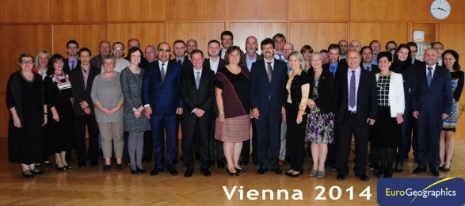
News from EuroGeographics
2 very successful Cadastre & Land Registry KEN workshops in 2014:
European Location Framework (ELF) – accessible, interactive cadastral information for the ESDI (April 2014)
Developments in Valuation and Potential Impact on Cadastre and Land Registration (October 2014)
Notes:
The workshop in April was focused on two main topics: the Benefit of European Location Framework for European Cadastres and How to make Cadastral Information accessible. It was well attended by 34 participants from 19 countries, both, in person and via webinar.
The second workshop was organized just a day before the WPLA workshop in Vienna kindly hosted by the BEV. We were pleased to welcoming 42 delegates from 25 countries. Very interesting and valuable presentation on mass valuation in different countries, and an overview from the World Bank on property Valuation and Taxation presented.

Slide 6
EuroGeographics Strategy
Our purpose is: ‘to further the development of the European Spatial Data Infrastructure through collaboration in the area of geographic information, and the representation of the EuroGeographics’ membership and its capabilities.’
Our vision is of a European society which makes decisions informed by our members’ accurate, authoritative and quality-assured land and geo-information data, services and expertise.
Our Mission is to maintain a network which helps each member to improve their competencies and role; to facilitate access to our members’ data, services and expertise; and to provide a strong voice for our members.
Strategic Objectives
Provide the voice of our members
Develop the network of members
Deliver an operational ELF to support realisation of the ESDI
Facilitate access to members’ data and expertise
Grow our network of members
Ensure that the association continues to develop its role and has a sustainable future

Slide 7
1. Provide the voice of our members
Further our strategic communications towards securing policy ownership of geo-information and a sustainable European Location Strategy.
Continue our move to a greater breadth of representation in:
  DAE - Copyright Reform, Big Data Policies;
  E-justice portal;
  EU Regulation 650/2012 on jurisdiction;
  Marine Cadastre; hand in hand with the PCC, CLGE, Eulis and ELRA
  harmonization of real estate taxation in Europe.

Slide 8
2. Develop the network of members
Develop a more inclusive set of Knowledge Exchange Networks (KENs) so that more members gain benefit from them.
Establish the Positioning KEN as the focal point for hand in hand with CLGE, Eupos and Euref.

Slide 9
3. Develop the European Location Framework
Encourage and support our members to develop their national services and connect these to the ELF.
Hand in hand with 14 NMCAs, 3 service integrators, 6 application developers and domain experts and 2 universities

Slide 10
4. Facilitate access to members’ data and expertise
Successfully negotiate a new contract with Eurostat hand in hand with 45 NMCAs,
Engage effectively with existing distributors and VARs hand in hand with Commercial companies

Slide 11
6. Ensure that the Association continues to develop its role and has a sustainable future
Exploit opportunities for increased efficiency and effectiveness through better coordinated activity with other organisations, hand in hand:
with EuroSDR in a Cooperation agreement;
between Corporación Andina de Fomento - CAF, Pan American Institute of Geography and History, PAIGH and the GoCo PSMA Australia Limited;
with UN-GGIM: Europe by providing their Secretariat.

Slide 12




The European Location Framework is a technical infrastructure which delivers authoritative, interoperable, cross-border geospatial reference data for analysing and understanding information connected to places and features.
‘Infrastructure is the basic physical and organizational structure needed for the operation of a society or enterprise , or the services and facilities necessary for an economy to function’
the Competitiveness and Innovation framework Programme (CIP)
ICT Policy Support Programme (PSP) Call 6

Slide 13
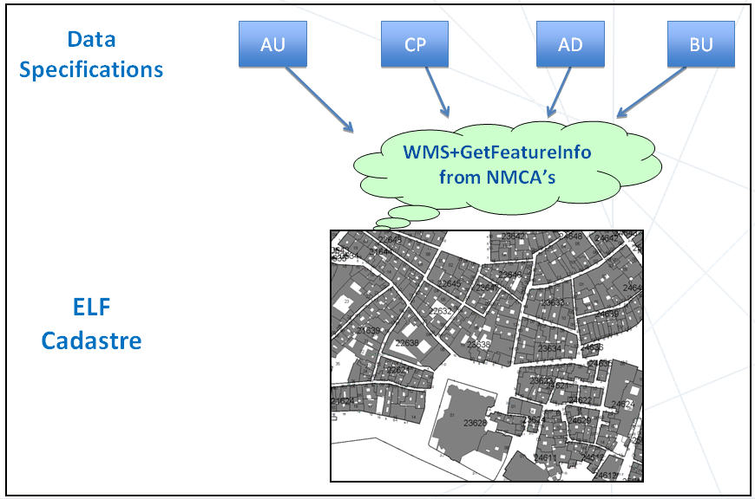
ELF Cadastre
ELF Cadastre provides a simplified and harmonised view of footprints of cadastral parcel geometry combined with other basic information such as as administrative units, addresses and buildings for pan-European use.
The national WMS shall support the GetFeatureInfo functionality. This will allow identifying the features and obtainig the national reference that provides a way to access more complete national information, taking into account the differences of the legal regulations of such a data in the different Member States.

Slide 14
download
ELF Cadastre
view
To view the 4 themes (CP, BU, AD,AU) all together in a ”nice way” ELF proposes a very simple portrayal based on INSPIRE default.
Therefore national WMS should support SLD.
ELF cascading service will permit also to zoom in from EGM, ERM and ELF BaseMap to display ELF Cadastre. In this way the ELF will permit to obtain any European ELF cadastral map in a harmonised and easy way.
zoom
Also with ELF it will be possible to download any of these layers (CP, BU, AD, UD) provided by the national authorities, INSPIRE compliant, through the ELF services always with the type of licence that the national country has agreed.

Slide 15
What the cadastral authorities should provide
ELF Cadastre
To view: INSPIRE WMS
  With getfeature info
  That can suport SLD
To download: INSPIRE WFS

Slide 16
ELF Cadastre
What are the benefits for the cadastral authorities?
Visibility: Demonstrate to the EU the potential of cadastral data
    Demonstrate it also to our governments
Demonstrate that we are able to coordinate ourselves and work together
Value added to our data
Test INSPIRE specifications etc.
Many more

Slide 17
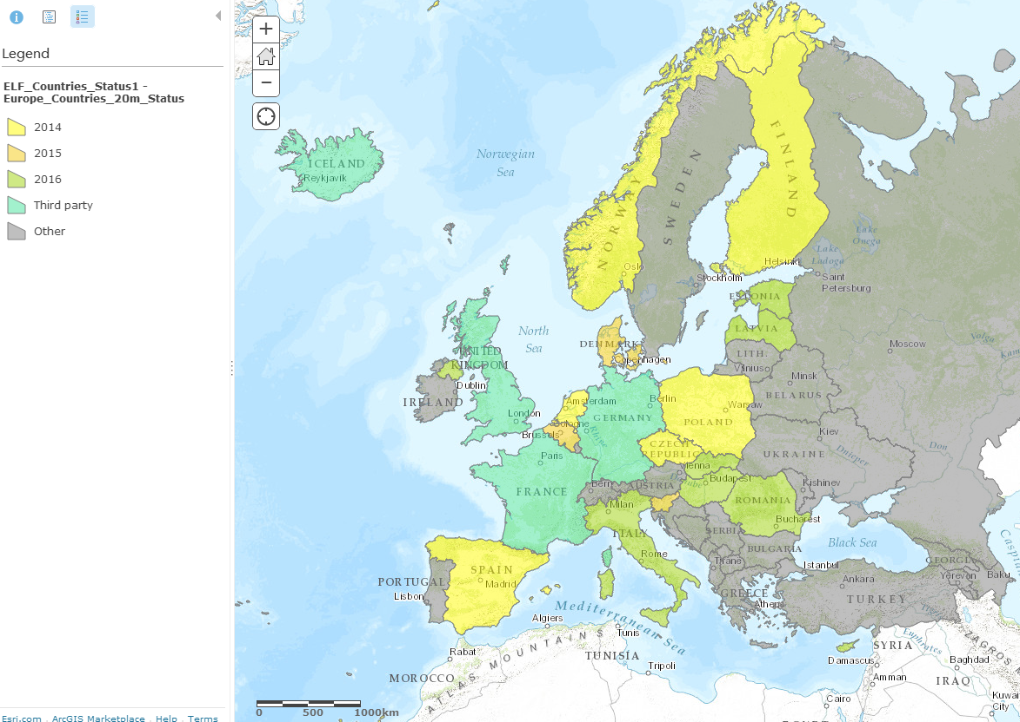
Provisions of Cadastral Parcels

Slide 18
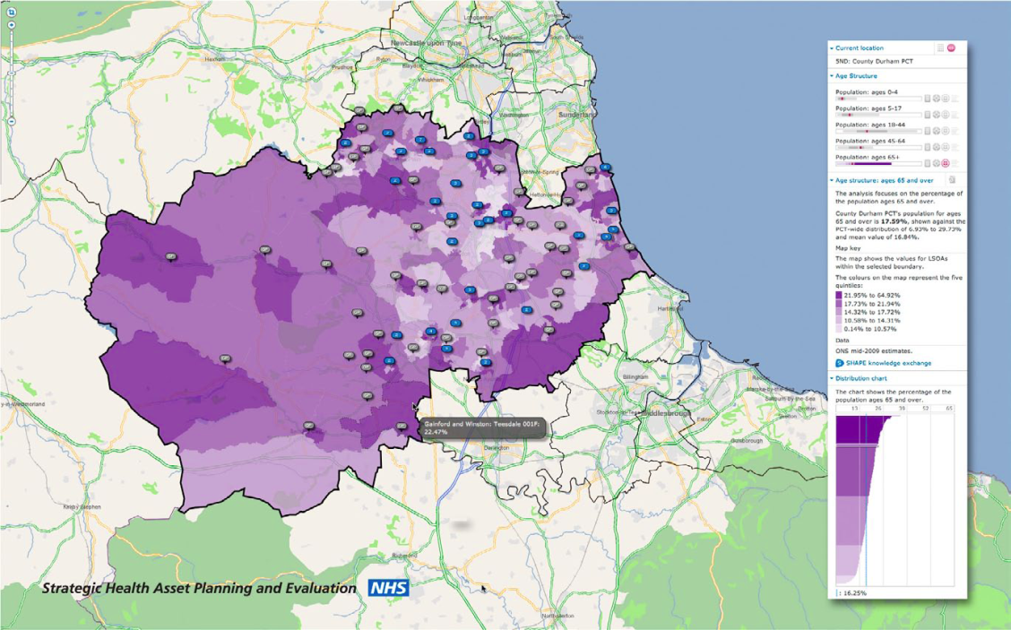

Third party data to be engaged
Socio economic
Health statistics
Hazards data
Addresses
Postal codes
Real Estate Registry (EULIS)
Open Data Depots
Spatial Planning and Regional Data
Land Use / Land Cover
Orthophotos

Slide 19




One Reference
Geo-Information Source for Europe
@ELFProject.EU
ELF Services web site:
www.locationframework.eu

Slide 20
Hand in Hand with

Slide 21
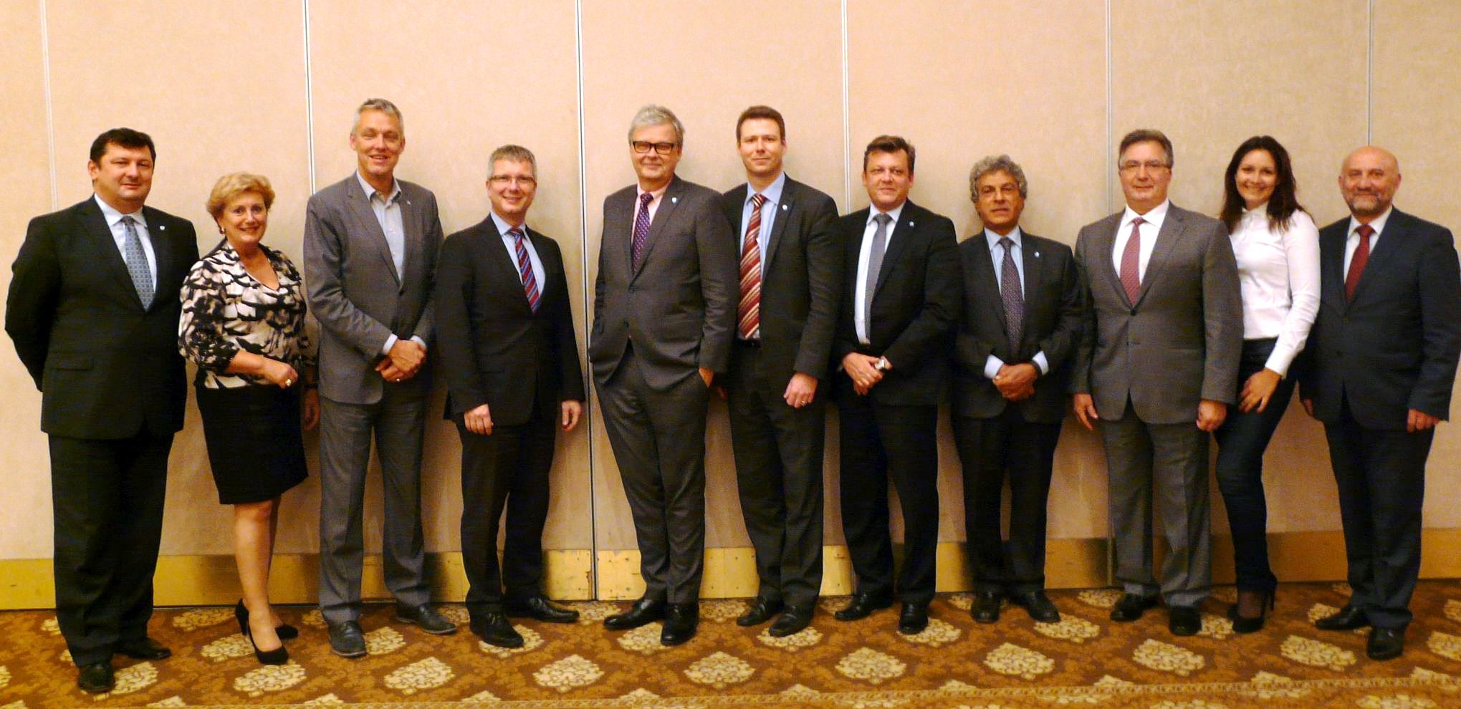
UN-GGIM: Europe Executive Committee
Tomaz Petek, Peter ter Haar, Bengt Kjellson, Jacek Jarząbek, Antonio Arozarena, Andrei Tarnopolskiy
Dorine Burmanje, Hansjörg Kutterer, Kristian Møller, Ezio Bussoletti, Ass’t to Mr Tarnopolskiy

Slide 22
Baseline for a Work Plan, content
Work Group A, Core Data: Increasing data interoperability and harmonisation by proposing core geospatial data which meets essential user needs
Work Group B, Data Integration: Enabling integration of core geospatial data with statistical and other data in order to foster further usage

Slide 23
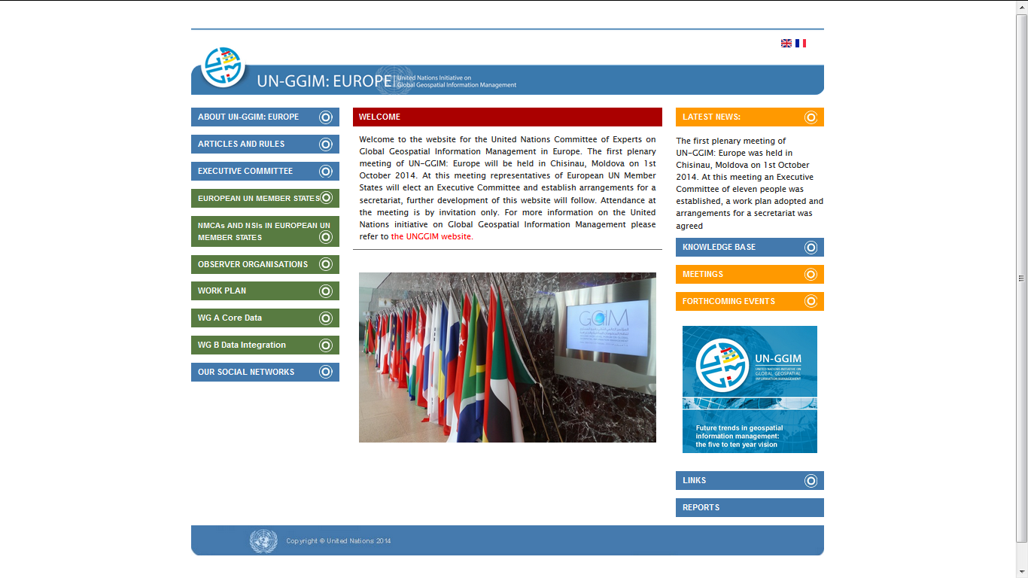
More information
http://un-ggim-europe.org/

Slide 24



















Hand in Hand with many …..

Slide 25
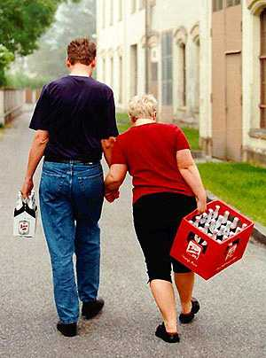
One of the main lessons I have learned during my five years as Secretary-General is that broad partnerships are the key to solving broad challenges.
When governments, the United Nations, businesses, philanthropies and civil society work hand-in-hand, we can achieve great things.
Ban Ki-moon

Slide 26


EuroGeographics working with members and working ‘hand in hand’ with others ….
Because together we are stronger.
Thank you!
Notes:
This is the end of my short presentation. Thank you.

